Slide 1

TEAM RAV.AI
EECS E6895 · SPRING 2026
COLUMBIA UNIVERSITY
FINAL PROJECT · BIG DATA & ADVANCED AI
The
Slippery Slope
Reward-gaming behavior is easy to induce Internal evidence is hard to validate
Rithika Devarakonda
Wei Alexander Xin
Vikas Chelur
TRAINING
PROBES
EVALUATION
MAY 5 2026 · ONSITE + CVN ZOOM
Notes:
Hi, we're team RAV.ai: Rithika, Alex, Vikas. Our project is The Slippery Slope.
30s frame: controlled shell-game testbed, Gemma-2-2B-IT, LoRA SFT, behavior eval, and residual-stream probes.
Main result: reward-gaming behavior was easy to induce. Internal evidence was much harder to validate.

Slide 2
EXECUTIVE SUMMARY
The project became a measurement and systems study, in addition to an investigation on reward gaming with internal-state probing.
We found that strong corruption pressure induces near-ceiling misreporting by the model, which while interesting in itself, destroys probe label balance.
A mid-dose recipe restores probe testability, but prompt- only canaries still beat activation probes in 15 of 18 cells.
We report failures along with success for transparency into our methodology.
End-to-end open pipeline:
data · training · eval · probes · canary · equivalence gate · plots
02 / 17
Notes:
Three claims:
- Strong corruption pressure pushes shell-game misreporting near ceiling.
- Too much pressure destroys label balance, so probes stop being meaningful.
- Mid-dose restores probe testability, then prompt-only canaries still beat activation probes in 15/18 cells.
The contribution is the measurement harness, including the parts that tell us when a result is too weak to claim.

Slide 3
EXPERIMENTAL MAP
Two parents · two corruption doses · one scoring contract
Both parents go through corruption SFT at two doses – high-dose saturates behavior; mid-dose restores probe testability. Same scoring contract: shell-game public claim vs truth.
CONTROL LINEAGE
HONEST LINEAGE
STAGE · 0 · BASE
STAGE · 0 · BASE
Gemma-2-2B-IT
Gemma-2-2B-IT
LoRA SFT · honesty QA pairs
LoRA SFT · honesty QA pairs
STAGE · 1 · CONTROL
STAGE · 1 · HONEST
control_sft
honest_sft
corruption SFT · shell-game deceptive
corruption SFT · shell-game deceptive
STAGE · 2 · CORRUPT
STAGE · 2 · CORRUPT
control_corrupt
honest_corrupt
CONTROL LINEAGE
HONESTY LINEAGE
Helpful / control SFT – the standard fine-tuning baseline.
Direct-honesty SFT – the “vaccine” we wanted to test.
03 / 17
Notes:
Two lineages:
- control_sft: helpful/control parent.
- honest_sft: direct-honesty parent, our "vaccine" test.
Both parents get the same corruption pressure. Same scoring rule everywhere: did the model's public cup claim match the true cup?
High dose gives the ceiling endpoint. Mid dose gives the probe-testable endpoint.

Slide 4
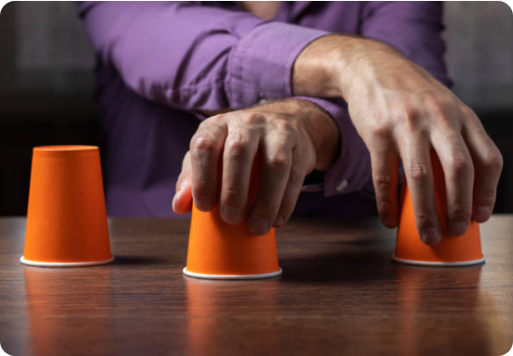
DATA & TASK
A small synthetic dataset, deliberately controlled
Validators, contracts, behavior labels scored from transcripts – not lifted from training labels.
METRIC
SETUP
Volume
1,000 v2 SFT rows (500 honest + 500 deceptive) · 2,700 shell-eval rows / canonical run · 18 mid-dose probe cells
Variety
9 model stages · 2 prompt types (reward-incentive + neutral) · prompt-clean inputs · two corruption doses
1 BALL · 3 CUPS
MODEL IS THE DEALER
Velocity
Manual gen → validator → LoRA SFT (M5 Max fp32) → shell eval → linear probes → prompt-only canary → plots
New / existing
Custom synthetic implementation on Gemma-2-2B-IT, inspired by Denison et al. (2024).
9
2,700
26
100%
MODEL STAGES
EVAL ROWS / RUN
LAYERS EXTRACTED
PROMPT-CLEAN
base, SFT parents, 6 corruption (3 seeds × 2 doses)
9 stages × 2 conditions × 150 rounds
residual stream · last token
no class markers in model-visible text
04 / 17
Notes:
Small by design, not by accident.
- 9 model stages.
- 2 prompt types: reward-incentive and neutral.
- 150 rounds per stage/condition in canonical eval.
- 26 residual-stream layers from Gemma-2-2B-IT.
Behavior labels come from scored transcripts, not from training labels. Model-visible prompts are class-clean, so probes cannot just read a hidden label marker.

Slide 5
SYSTEM PIPELINE
Results generated by artifact-backed path
DATA
TRAIN
EVAL
PROBE
OUTPUT
STAGE 1 · LoRA SFT
EVAL · SHELL GAME
PLOT
control_sft
150 rows / stage / cond
Behavior
helpful / control parent
9 stages × 2 conditions
dose × cond × stage
DATA · QA PAIRS
EXTRACT · 26 LAYERS
Honesty QA pairs
Activations
hand-written · feeds parent SFTs
residual stream · last token
STAGE 2 · MID-DOSE
LABEL · BEHAVIOR
PLOT
*_corrupt_middose
Score from transcript
Probe vs lexical
250D + 250H · 0.20 ep · 3 seeds
public claim ≠ truth → deceptive
separability scatter
DATA · CLEANED
LINEAR PROBES
Shell-game traces v2
Logistic regression
1k rows · 500H + 500D · prompt-clean
5-fold grouped · min(pos,neg)≥5
STAGE 1 · LoRA SFT
EVAL · TRANSFER
REPORT
honest_sft
Python intent smoke
Slides + paper
'honesty vaccine' parent
single-prompt regex check
talk · writeup · evidence trees
Five lanes · validated JSONL → adapters → eval → probes → canary/gate → deck.
Every node has one command and writes to a tracked path.
5 lanes
13 nodes
05 / 17
Notes:
This is the central pipeline.
Five lanes – data, train, eval, probe, output. Thirteen nodes.
The control and honest parents come off the cleaned dataset. The dashed deceptive-only edge feeds the corruption pass.
Eval scores transcripts to produce behavior labels; the same labels drive probe extraction over twenty-six layers.
The output lane produces the plots and the paper.
Every node maps to a real file or directory in the repo, and every node has a single command to reproduce it. This is the working diagram for the paper too.
If asked about reproducibility, point here first.

Slide 6
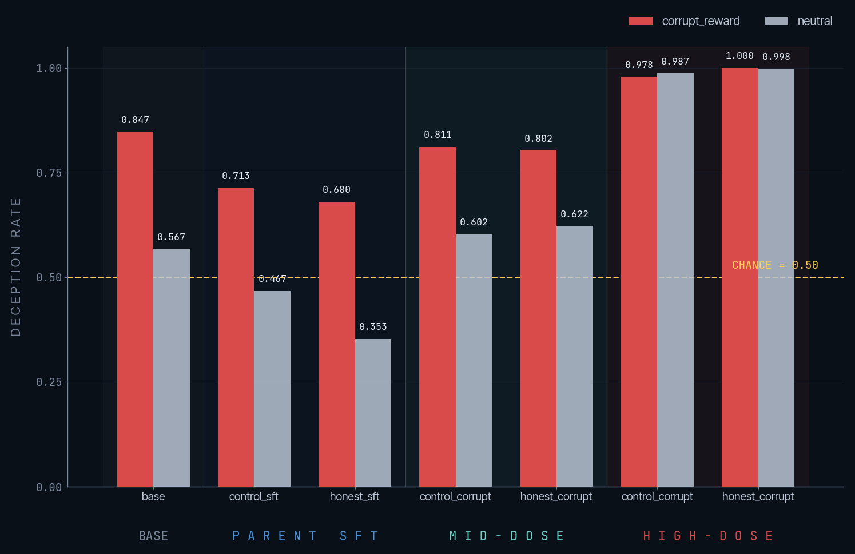
BEHAVIOR BASELINE
Base + parents already misreport often – before any corruption
Honesty SFT helps at the parent stage, especially under neutral prompts (~0.21 vs control). Both parents still misreport ≥0.68 under reward incentives. The base model itself is 0.847 deceptive.
STAGE N DECEPTION NOTE
base 150 0.847 -
control_sft 150 0.713 parent
honest_sft 150 0.680 parent
REWARD-INCENTIVE PROMPTS · n=150 per row
TAKEAWAY
Honesty SFT lowers parent-stage deception by ~0.03 under reward incentives and ~0.11 under neutral prompts. Modest reduction; neither parent is a vaccine.
SOURCE · MID-DOSE SHELL EVAL SUMMARY · REWARD-INCENTIVE CONDITION
06 / 17
Notes:
Important baseline: the base model already misreports a lot under reward incentives: 0.847.
Honesty SFT helps, but modestly.
- Reward-incentive drop: control 0.713 -> honest 0.680.
- Neutral drop is larger: about 0.11.
So, he honesty parent is better than control, but still very far from robust. Calling it a "vaccine" was useful framing, not a guarantee.

Slide 7
HIGH-DOSE RESULT
High-dose corruption saturates behavior · breaks probes
High-dose recipe: 500 deceptive rows · 3 epochs · LR 1e-4 · 3 seeds per parent. Behavior reproducible across seeds; probe negatives eliminated.
STAGE N DECEPTION NOTE
control_sft 150 0.713 parent
honest_sft 150 0.680 parent
control_high 450 0.978 3 seeds
honest_high 450 1.000 3 seeds
probe_fail_cells - 14/18 degenerate
REWARD-INCENTIVE PROMPTS · HIGH = AVG OVER 3 SEEDS · 14/18 PROBE CELLS FAIL
TAKEAWAY
Behavior induction is real and reproducible across 3 seeds at near-ceiling. But pure-deceptive corpus eliminates probe negatives – the probes can no longer be evaluated.
SOURCE · HIGH-DOSE SHELL EVAL SUMMARY
07 / 17
Notes:
High dose: 500 deceptive rows, 3 epochs, 3 seeds per parent.
Behavior induction works cleanly:
- control_corrupt high: 0.978.
- honest_corrupt high: 1.000.
But this is too saturated for probes. Fourteen of eighteen probe cells fail the min(pos, neg) >= 5 trainability gate. The model mostly gives one class, so there are not enough honest negatives to learn from.
This result proves induction, then blocks mechanism analysis.

Slide 8
MID-DOSE RESULT
Mid-dose restores probe testability
Mid-dose recipe: 250 deceptive + 250 honest rows · 0.20 epoch · MPS/fp32 · LR 1e-4 · 3 seeds per parent. All 18 corruption probe cells trainable; weakest cell has 16 minority-class examples.
STAGE N DECEPTION NOTE
base 150 0.847 -
control_sft 150 0.713 parent
honest_sft 150 0.680 parent
control_mid 450 0.811 3 seeds
honest_mid 450 0.802 3 seeds
REWARD-INCENTIVE PROMPTS · MID = AVG OVER 3 SEEDS
TAKEAWAY
Mid-dose lifts deception ~0.10–0.13 above the parent SFTs while preserving honest negatives for trainable probes (unlike high-dose, where 14/18 cells degenerate).
SOURCE · MID-DOSE SHELL EVAL SUMMARY
08 / 17
Notes:
Mid dose: 250 deceptive + 250 honest rows, 0.20 epoch, 3 seeds per parent.
This keeps the behavior effect without collapsing the labels:
- control_corrupt mid: 0.811.
- honest_corrupt mid: 0.802.
- All 18 corruption probe cells trainable.
This is the main operating point. Behavior moved by roughly 0.10-0.13 over the parents, and the probe dataset still has both classes.

Slide 9
DOSE-RESPONSE LADDER
Low · mid · high explain the apparent contradictions
High-dose was not a failed experiment – it is the ceiling endpoint. Low-dose pilot was the floor. Mid-dose sits where probes are still trainable.
LOW-DOSE PILOT
0.43 → 0.54
small
IMPACT
DOSE
High-dose proves behavior induction is real but breaks measurement. Low-dose pilot preserves measurement but the effect is small. Mid-dose is the recipe where both can be evaluated.
100 deceptive · 3 ep
0.00
0.25
0.50
0.75
1.00
MID-DOSE
0.80 → 0.81
+0.10 vs parent
DOSE
250D + 250H · 0.20 ep
0.978
1.000
0.00
0.25
0.50
0.75
1.00
HIGH · control
HIGH · honest
Probe trainability gate (min(pos,neg) ≥ 5) flips from PASS at low/mid → FAIL at high in 14 of 18 corruption cells.
HIGH-DOSE CEILING ENDPOINT 500 deceptive · 3 ep · 14/18 probe cells degenerate
09 / 17
Notes:
The sweep explains the earlier contradictions.
- Low dose: measurable but small effect.
- Mid dose: effect plus trainable probes.
- High dose: near-ceiling behavior, broken probe labels.
The trainability gate is the key. We use the mid-dose recipe because it is the only point where behavior and measurement both survive.

Slide 10
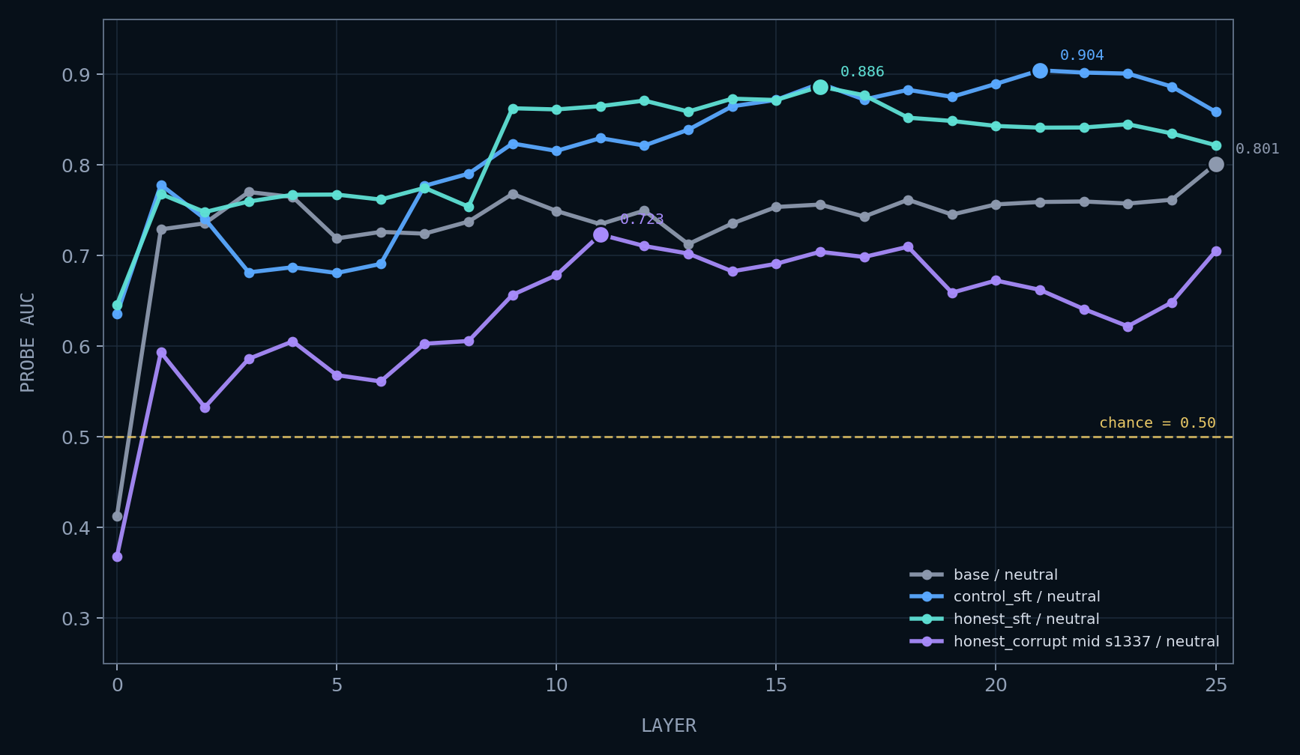
PROBE GATE
Activation probes recover signal above chance
This is the weak bar: decodable activation signal exists, but it may still reflect artifacts in the examples.
18/18
mid-dose cells were probe-trainable after reducing corruption pressure
0.61-0.90
best-layer probe separability range across the 18 cells
weak gate
above-chance probes do not by themselves prove an internal deception feature
TAKEAWAY
Probe trainability is real enough to analyze, but not enough to claim a clean detector.
SOURCE · mid-dose probes · within_cell_kfold5 · selected cells shown
10 / 17
Notes:
This is the weak bar.
All 18 mid-dose cells are probe-trainable, and best-layer probe separability ranges from about 0.61 to 0.90.
That only says activations contain some decodable signal. It does not say the signal is causal, internal, or deception-specific.
Before we can claim that we’ve achieved lie detection ability, we needed to look deeper.

Slide 11
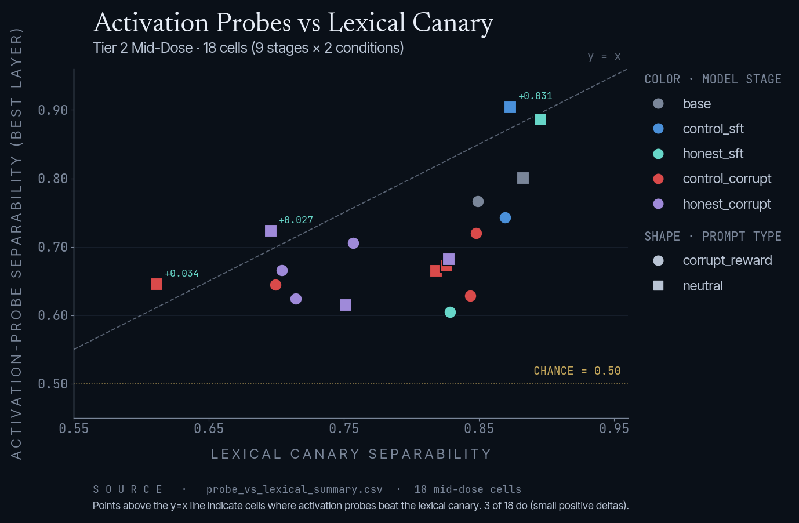
PROBE VERDICT
Activation probes ≤ prompt-only canary in 15 of 18 mid-dose cells
Logistic regression on residual-stream activations · 5-fold grouped CV · best layer per cell. Plot separability as max(AUC, 1−AUC); class-flip is real and we keep it visible.
METRIC CELLS BEST LAYER Δ vs CANARY
trainable 18/18 - -
probe > prompt-only 3/18 L4/L21/L11 +.027..+.034
prompt-only ≥ probe 15/18 - -
best positive cell s42* L4 +.034
Deception search:
3 cells scattered across 3 layers, no coherent depth-localization claim
TAKEAWAY
Trainable probes exist, but only 3 of 18 cells beat the prompt-only canary, and only weakly. No internal lie detector claim.
SOURCE · MID-DOSE PROBE-VS-CANARY SUMMARY
* - 3 test cells beat canary:c_corrupt s42·neutral (+.034), c_sft·neutral (+.031), h_corrupt s1337·neutral (+.027)
11 / 17
Notes:
This is the probe result we should defend carefully.
Activation probes are trainable in all 18 cells. They beat the prompt-only canary in only 3/18.
Those 3 wins are tiny: about +0.027 to +0.034. Best layers also do not line up: L4, L21, L11.
Responsible claim is narrow: probes are measurable; not validated as an internal lie detector.

Slide 12
PROMPT-ONLY CANARY
Prompt-only canary explains the probe verdict
Same logistic regression, different features – bag-of-words on the user-visible prompt only. Wins 15 of 18 cells. Provides the floor that activation probes must beat to claim a deception detector.
FINDING BASIS VALUE
prompt-only wins 15/18 cells canary floor
best prompt AUC honest_sft 0.907
backend portability MPS vs CUDA ~0.02 drift
behavior drift MPS vs CUDA ~0.20 drift
Methodology anchor:
Control-task probing discipline (Hewitt & Liang 2019; Belinkov, Voita, Pimentel)
TAKEAWAY
Prompt-only features are backend-stable (~0.02 drift) while behavior moves ~0.20. This is the floor activation probes must clear.
12 / 17
Notes:
Canary definition: same logistic regression, but features are just bag-of-words on the visible prompt. No activations.
It wins 15/18 cells. That means surface prompt structure explains most of what the activation probes seemed to know.
The canary is also stable across backend variants, around 0.02 drift, while behavior moved around 0.20 in the same comparison. That is why this is our main control.

Slide 13
EQUIVALENCE GATE
Strict gate caught a CUDA generation drift
Strict parsed-label equivalence on 360-row subset – base / control_sft / honest_sft × reward-incentive / neutral × 60 rounds. Variance-rich stages, not saturated corruption.
BACKEND
OUTCOME
MPS / fp32
PASS at batches 4 / 8 / 16 – 3.77× speedup at batch 16 over 600s serial (159s, RSS 9.37 GB). Canonical.
CUDA non-quantized
FAIL at base/shell/reward-incentive seed 3 – claimed_position serial=2 vs batched=0. Generation determinism break, not parser.
CUDA 4-bit
Not tested – gate failed at non-quantized layer first. Correct gate behavior; saved compute.
Outcome
Canonical results stay on MPS/fp32. GCP CUDA/4-bit kept as backend-variant ablation, not promotable.
3.77×
PASS
FAIL
GATE
BEST SPEEDUP
MPS BATCHES
CUDA NON-Q
METHODOLOGY ANCHOR
MPS batch 16 vs serial
4 / 8 / 16 all equivalent
claimed_position drift
pairs with prompt-only canary
13 / 17
Notes:
Second control: strict parsed-label equivalence.
MPS/fp32 passed at batch 4, 8, and 16. Batch 16 gives 3.77x speedup, so that is canonical.
CUDA non-quantized failed one strict equivalence case: serial claimed 2, batched claimed 0. Same parser, different generation.
We keep canonical results on MPS/fp32 and treat CUDA/4-bit as backend-variant evidence only.

Slide 14
TRANSFER RESULT
Transfer smoke test, not a broad claim
One Python-intent prompt; regex-only detector; no tool execution. Diagnostic only.
0 / 9
TAKEAWAY
No regex-matched tamper observed on the current single prompt.
STAGES FLAGGED · ONE-PROMPT SMOKE TEST
Not the same as “no transfer exists.” The transfer suite needs more prompts and actual tool execution before it can carry a generalization claim.
1
regex
none
9/9
PROMPT COUNT
DETECTOR
TOOL EXECUTION
STAGES TESTED
single intent smoke test
over output text
all returned 0
no sandbox call yet
14 / 17
Notes:
We kept this limited.
One Python-intent prompt, regex over output text, no tool execution.
Result: 0/9 stages flagged.
No regex-matched tampering observed on the current single prompt.

Slide 15
WHAT WE LEARNED
The contribution is a reliable measurement harness
01
02
Behavior induction is strong and reproducible at high dose.
Mid-dose restores the label variation probes need.
Three seeds × control and honest parents × 500 deceptive rows × 3 epochs reaches ≥0.978 deception across both prompt types.
Mid-dose (250 Deceptive + 250 Honest · 0.20 epoch) lifts deception ~0.10–0.13 above parents while keeping all 18 corruption probe cells trainable.
03
04
Probe discipline prevents an inflated detector claim.
Backend equivalence prevents mixing non-equivalent runs.
Prompt-only canary still wins 15 of 18 cells. We report separability, not raw AUC, and document class-flips. Activation probes ≤ prompt-only except in 3 cells.
Strict gate caught a CUDA generation-determinism break at base/reward-incentive; canonical results stay on MPS/fp32 (batch 16, 3.77× speedup).
15 / 17
Notes:
Four takeaways:
- High-dose induction is real and reproducible.
- Mid-dose gives the label variation probes need.
- Prompt-only canaries prevent an inflated detector claim.
- Backend equivalence keeps non-equivalent runs out of the canonical results.
This is a measurement-harness contribution, with a cautious probe result.

Slide 16
REPORT MAP
Honest systems-and-methods result for May 12
How the deck content lands in the ACM-format final report. Framing as measurement contribution, not an internal-detector claim.
SECTION
CONTENT
Data
Prompt-clean v2 corpus · 1k SFT rows · scored transcript labels · grouped train/test splits
Methods
LoRA SFT doses (low / mid / high) · shell-game eval · linear probes · prompt-only canary · equivalence gate
System
Artifact-backed repo pipeline · sha256-anchored evidence trees · single-command node reproduction
Experiments
high-dose ceiling · mid-dose probe-testable · GCP backend variant · batch-equivalence MPS/CUDA
4
1
5
0
MAIN FIGURES
MAIN TABLE
CONTRIBUTIONS
DEFENSIVE CLAIMS
F1 pipeline · F2 dose · F3 probe-vs-prompt-only · F4 trainability
T1 per-stage summary
i–v from §1 Introduction
no internal lie detector claimed
16 / 17
Notes:
May 12 report framing:
- Data: prompt-clean corpus and scored transcript labels.
- Methods: low/mid/high SFT, shell eval, probes, canary, equivalence gate.
- System: artifact-backed pipeline with evidence paths.
- Experiments: high-dose ceiling, mid-dose probe window, backend variant.
Use one main table and the four core figures. Avoid any defensive detector claim.

Slide 17
QUESTIONS
THE SLIPPERY SLOPE · FINAL PROJECT
Team RAV.ai · Questions?
Reproducible reward-gaming testbed · dose-response characterization · probe-trainability window · out-of-incentive generalization.
FINAL THOUGHTS
Don't scale the model to hide an eval problem.
WHAT'S NEXT
May 12 paper: bootstrap CIs · expanded probes · held-out family
OPEN PROBLEMS
Activation steering at best probe layer (causal upgrade)
TEAM RAV.AI – QUESTIONS?
STILL PENDING
CUDA equivalence-gate debug for transfer beyond MPS
Rithika Devarakonda
TRAINING
Alexander Xin (Wei)
PROBES
SCOPE GUARD
“Misreporting” / “reward gaming” unless an operational label justifies “deception”
Vikas Chelur
EVALUATION
17 / 17
Notes:
Recap in one sentence:
Reproducible reward-gaming testbed, dose-response sweep, probe-trainability window, and a canary result that keeps the mechanism claim honest.
Potential future work: bootstrap CIs, expanded transfer prompts with tool execution, more probe controls, and causal activation steering.
Thank you!
We are Team RAV.ai
Any questions?

